Slide 1
BETER SKILLS & TEAM PERFORMANCE STUDY
SOFTWARE QUALITY UPM RESEARCH IN COLLABORATION WITH MIT
Notes:
Comment on eelisa

Slide 2
TABLE OF CONTENTS
01
02
03
INTRODUCTION
METHODOLOGY
RESULTS
04
CONCLUSIONS
A brief description of the conceptual framework
Detailed explanation of the situation and methods used
Statistical output of the study
Synthesis of key points and practical techniques

Slide 3
INTRODUCTION
01

Slide 4
EXPLANATION OF THE SUBJECT
Theoretical
- 1st individual exam
- 2nd individual exam
Final group project
SOFTWARE
QUALITY
- Project document
- Project presentation
Group practice
- 12 group activities
Notes:
Not included in this first iteration of the study
Evaluations are separated

Slide 5
COLLABORATION
The more collaboration,
the better performance
hypothesis
But how could we measure it?
To what extent does it affect overall performance?
How to improve entanglement?

Slide 6
RESEARCH RESOURCES
Data
WhatsApp
Teams
Surveys
Grades
12 groups
1 subject
60 College students
4 sources of data

Slide 7
SURVEYS DETAILS
NEO-FFI
DOSPERT
TEAM DIAGNOSTIC SURVEY
SCHWART
MORALS
HAPPIMETER.ORG
It assess personality in five main domains called OCEAN
It is a psychometric scale that assesses risk-taking
It is a well-validated instrument designed to diagnose the strengths and weaknesses of teams
It is a questionnaire developed for assessing individual differences
In values
It is a powerful survey to understand and measure the attitude of individuals

Slide 8
PROJECT GOALS
Define clear metrics that indicate collaboration in a working group
01
Study the correlation between entanglement and overall performance
02
Clarify the importance of
measuring interactions in a
professional environment
03

Slide 9
METHODOLOGY
02

Slide 10
DATA STAGES
Obtain maximum data quantity and quality with the available resources
Extract features from the data
for analysis
CLEANING
EXTRACTION
PROCESSING
Unify and filter the data obtaining the required format

Slide 11
02
EXTRACTION
01

Slide 12
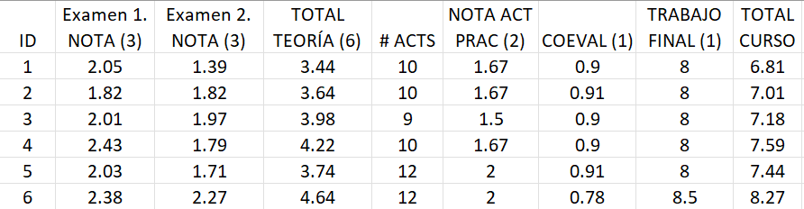
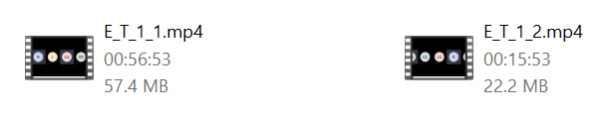

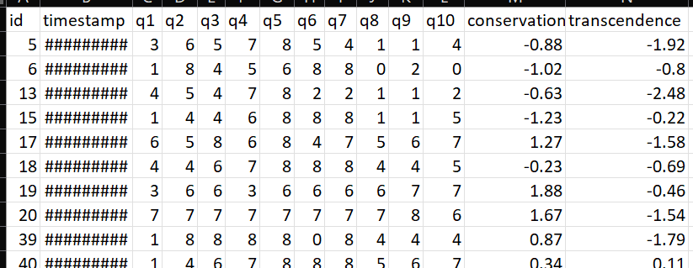
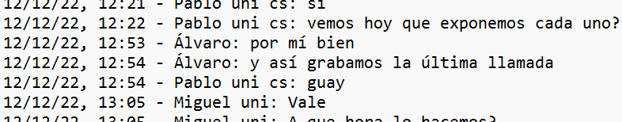
EXTRACTION OUTPUT
28 recordings (+20h)
1 spreadsheet
E_T_IdGroup_IdVideo.mp4
E_G.csv
E: Extraction
W: WhatsApp
T: Teams
G: Grades
12 groups
12 text files
4 spreadsheet
60 students
E_S#.csv
2 languages
E_W_IdGroup.txt

Slide 13
02
CLEANING
02

Slide 14
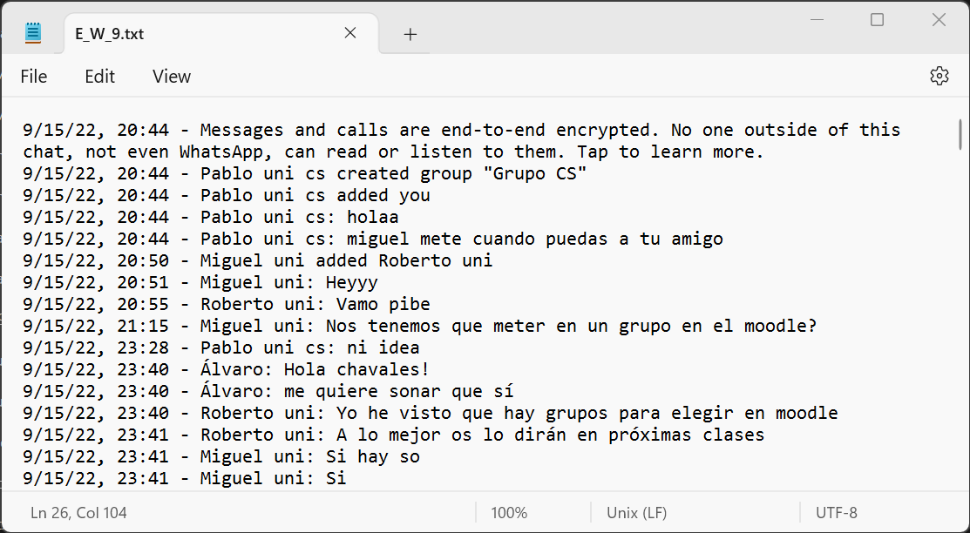
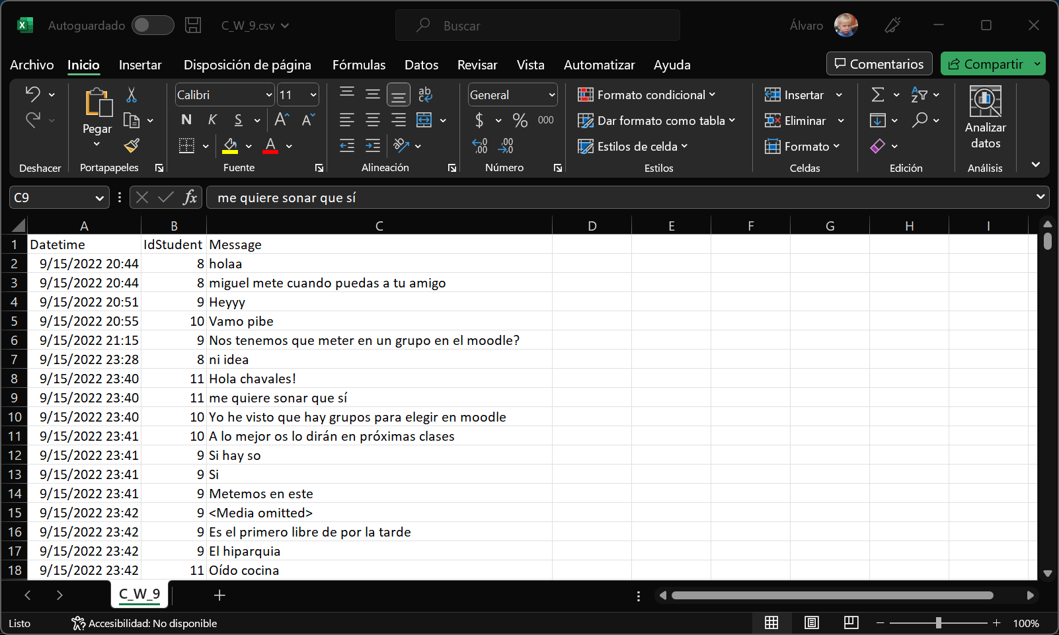
WHATSAPP CLEANING
INPUT TEXT FILE
OUTPUT CSV FILE
Main tasks
Select only the messages
Exchange the name for the id
Format date
C_W_9.csv

Slide 15
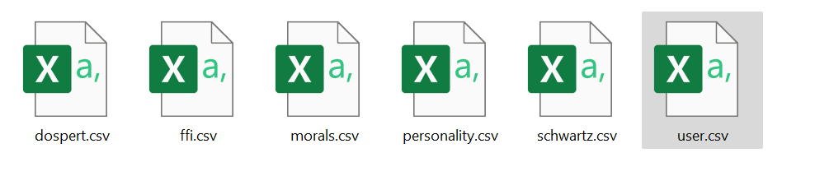
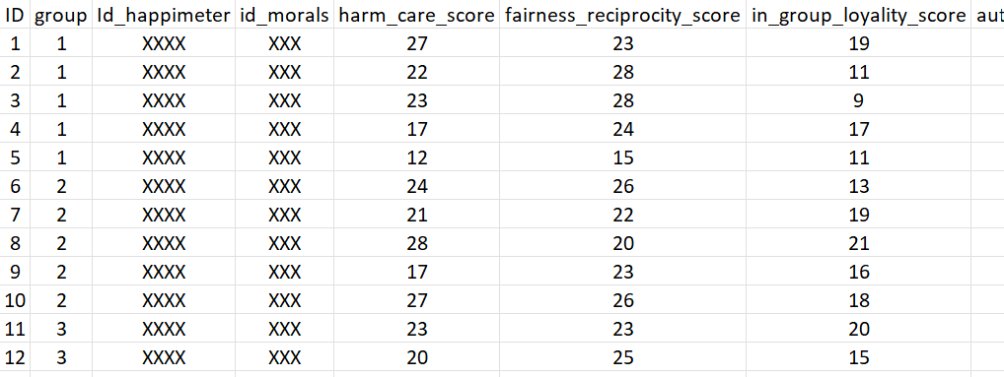
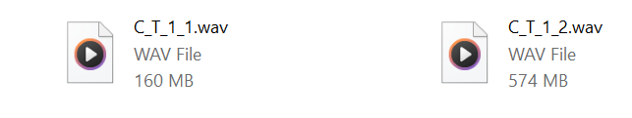
TEAMS CLEANING
SURVEYS CLEANING
surveys_individual_features.csv
Notes:
Was not mandatory to record faces so 10/12
Strip off for now video and focus on audio
Surveys got in their final form

Slide 16
02
PROCESSING
03
Notes:
I am referring to feature extraction, apply methods to get new information that wasn’t there

Slide 17
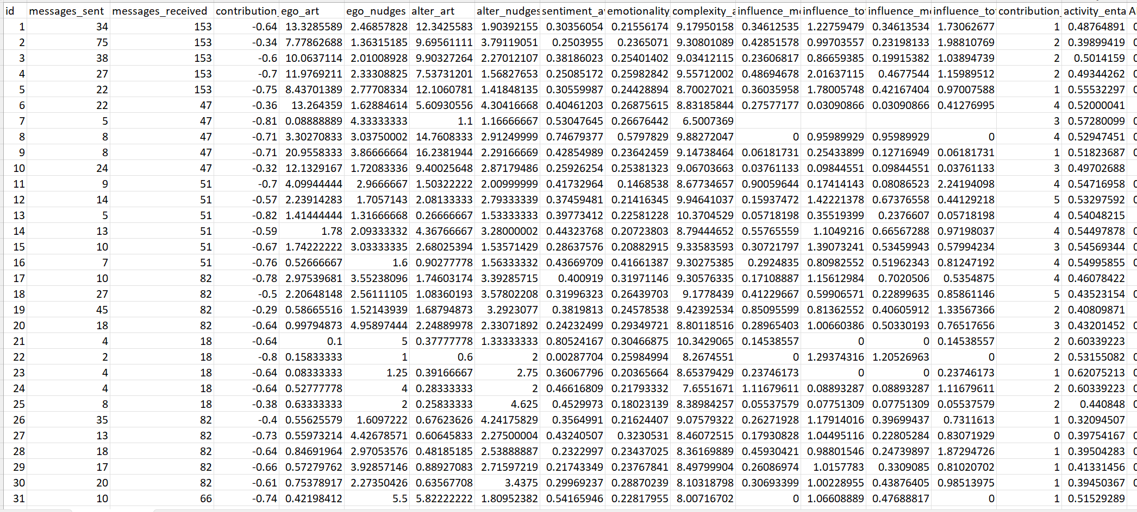

WHATSAPP PROCESSING
whatsapp_individual_features.csv
Used Griffin to extract features of each student
GRIFFIN
SNA software part of the GalaxyLens product developed by Galaxy Sciences. It fetches the source data and calculates the Honest Signals

Slide 18
WHATSAPP INDIVIDUAL FEATURES
TEXT EMOTION
SOCIAL NETWORK ANALYSIS
35 FEATURES
4 emotions:
Happy, fear,
sad and anger
messages_sent
contribution_index
ego_art
influence_total
activity_entanglement
….
ARCHETYPES
Groupflow
Alternative Realities
Behavioral Values
0
5
10
15

Slide 19
TEAMS PROCESSING v1
Wav File
Speaker
Diarization
*
meetings_info.csv
individual_info.csv
Speech to Text
Properties of each individual meeting like length, participants, shown_face…
Properties of each individual in all meetings like spoken_time, num_turns, happy_time…
**
Audio Analysis
Text
Analysis
group_meetings_info.csv
Output file containing aggregated variables for each group from the files above
Feature
Extraction
Emotion
Recognition
Emotion
Recognition
Feature
Extraction
https://github.com/pyannote/pyannote-audio.git
https://github.com/openai/whisper.git
*
**
Notes:
Nice results on diarization because of different mics
what should I do with emotions, text speech different variables or contrast
Features are not time features as tobias and moritz, they are absolute features

Slide 20
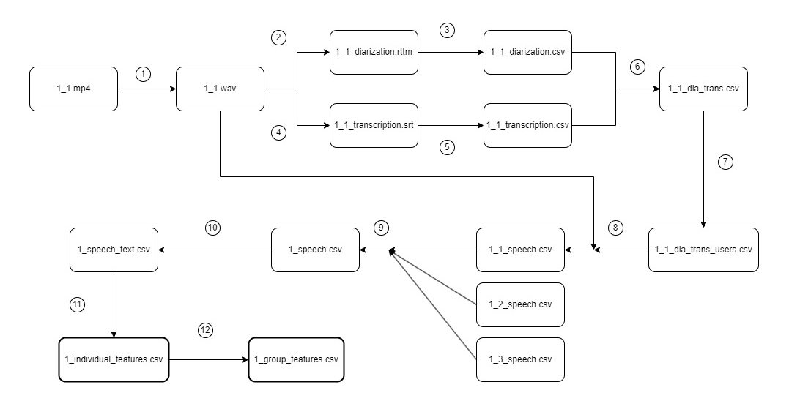
TEAMS PROCESSING v2
DIARIZATION
https://github.com/pyannote/pyannote-audio
TRANSCRIPTION
https://github.com/jianfch/stable-ts
SPEECH-EMOTION
https://huggingface.co/superb/wav2vec2-base-superb-er
TEXT-EMOTION
https://huggingface.co/bert-base-multilingual-cased
*
**
Notes:
Nice results on diarization because of different mics
what should I do with emotions, text speech different variables or contrast
Features are not time features as tobias and moritz, they are absolute features

Slide 21
MEETINGS INDIVIDUAL FEATURES
SPEECH EMOTION
TURN ANALYSIS
28 FEATURES
4 emotions:
Happy, neutral,
sad and anger
Individual_spoken_time
avg_turn_duration
max_time_without_speaking
avg_turns_without_speaking
avg_words_in_turn
….
TEXT EMOTION
4 emotions:
Happy, fear,
sad and anger
0
5
10
15
20

Slide 22
02
ANALYSIS
04
Notes:
Person correlation

Slide 23
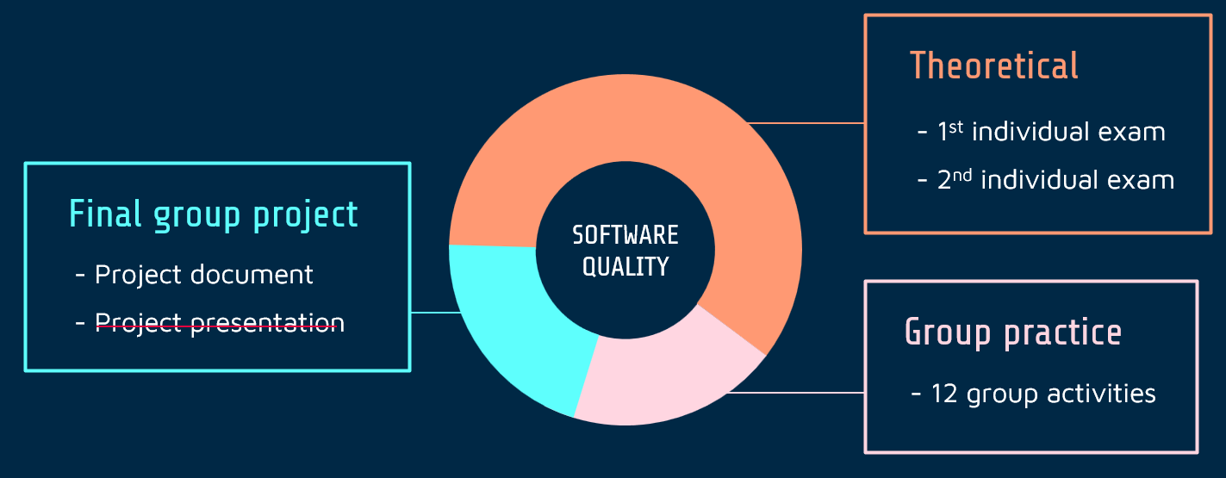
OBJECTIVE VARIABLE
INDIVIDUAL PERFORMANCE
Mean of the 2 exams
Evaluated by: teachers
Theoretical range: 0-1
Real range: 0.5-0.93
TEAM PERFORMANCE
Evaluated by: teachers
Theoretical range: 0-1
Real range: 0.6-0.9

Slide 24
RESULTS
03

Slide 25
THE IMPORTANCE OF BEES IN TEAM PERFORMANCE

Slide 26

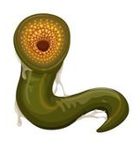

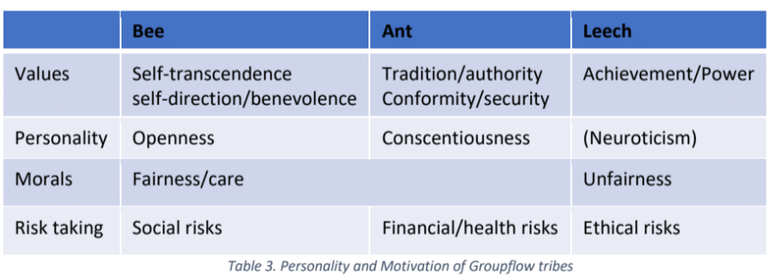
GROUPFLOW
Antflow
Beeflow
Leechflow
(Table from Happimetrics)
Notes:
Ants: close minded | things will remain always the same | win or lose | not intrinsically bad just scared
Leeches: want Power no matter what | they drain your energy | no altruistic morals | jungle
3. Bees: Desirable flow | Win win situations | not scare of givin | pure moral purpose | they tend to think collectively beehive | bring honey

Slide 27
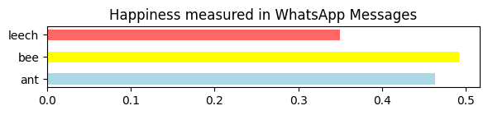
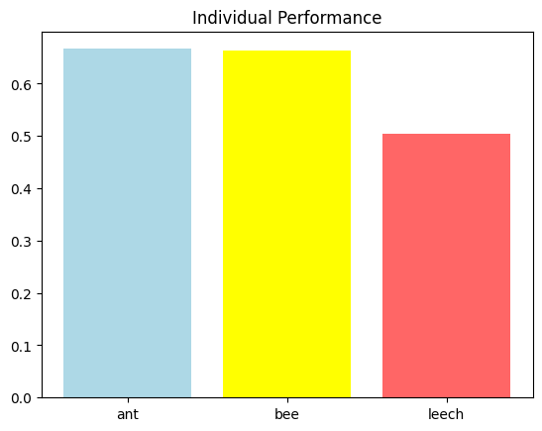
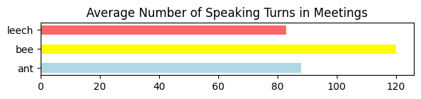
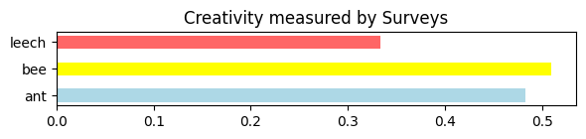
BEE ANALYSIS
LACK OF CONFIDENCE (PVALUE)
BEE TESTED CHARACTERISTICS
INDIVIDUAL PERFORMANCE
Notes:
We test characteristics for the rest of the communication channels, it further validates the concept
Teams with bees score on average 1.2 points more out of 10, which is even more appreciable knowing that the range of group scores is from 6 to 9
40 ants, 14 bees and 1 leech

Slide 28
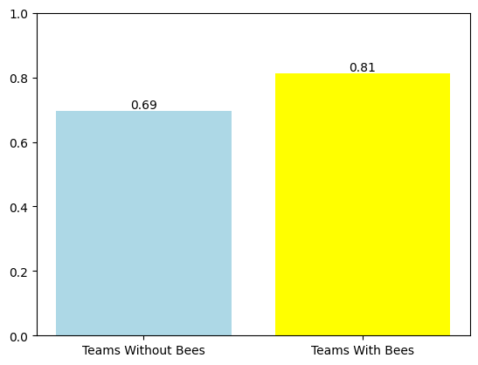
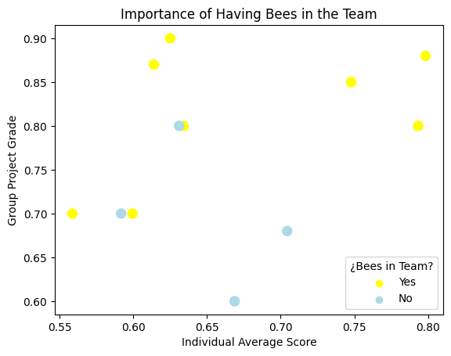
IMPLICATION IN PERFORMANCE
TEAM PERFORMANCE
INDIVIDUAL VS TEAM
Notes:
We believe it is important to highlight through the last graph, that in order to predict group performance, it is more important to have bees in the team than a high average individual performance

Slide 29
INDIVIDUAL PERFORMANCE PREDICTOR

Slide 30
MODEL PREPARATION
FEATURES
CLASSES
Contribution Index
Emotionally
+0.8
Happy Speech
Spoken Time Ratio
0.65 - 0.8
55 datapoints
Health Likelihood
Extraversion
0.5 - 0.65
Notes:
Mention data points

Slide 31
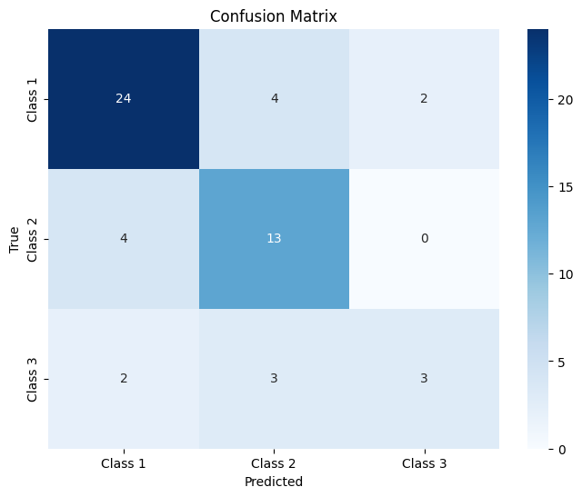
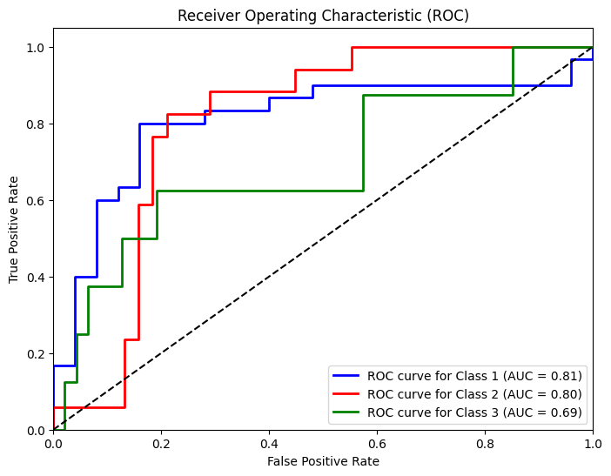
RESULT METRICS
Mean Cross-Validation Accuracy: 0.73

Slide 32
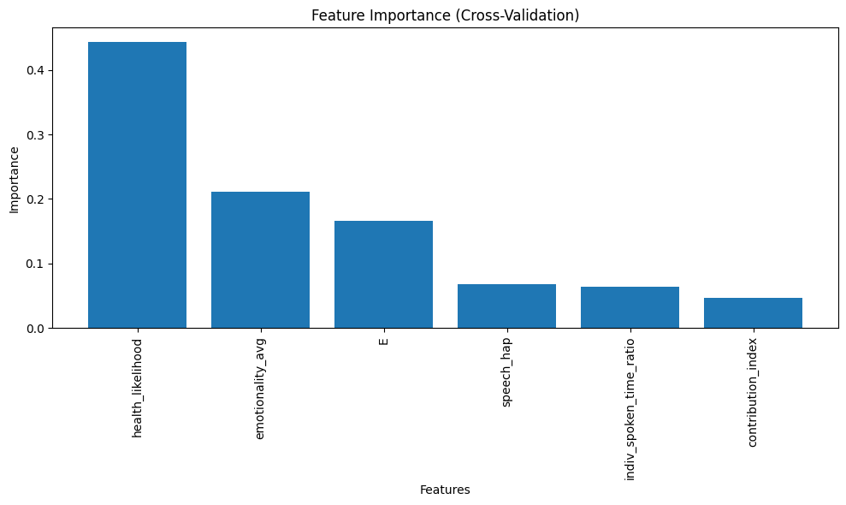
FEATURE IMPORTANCE

Slide 33
ANALYSIS
OBJECTIVE
VARIABLE
INDIVIDUAL PERFORMANCE
GROUP PERFORMANCE
GROUPS OF
CLASSIFICATION
Performance
(3 classes)
Performance
(3 classes)
Groupflow
Groupflow

Slide 34
OBJECTIVE
VARIABLE
INDIVIDUAL PERFORMANCE
GROUP PERFORMANCE
GROUPS OF
CLASSIFICATION
Performance
(3 classes)
Performance
(3 classes)
Groupflow
Groupflow
Best performers
max_time_without_spk
health_perceived
recreational_perceived
social_perceived
Classification model
Accuracy 0.73
harm_care_score
authority_respect_scorepurity_sanctity_score
group_performance
q6
q8
Best performers
recreational_perceived_mean

Slide 35
NEXT STEPS
WRITE A PAPER

Slide 36
THANKS FOR YOUR TIME
alvaro.francisco.gil@alumnos.upm.es
Notes:
Mention plants

